Slide 1
Using Gravitational Wave Observations of Binary Black Hole Mergers to Measure the Hubble Constant​
Manuel Coelho & Dan Everett

Slide 2
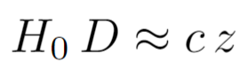
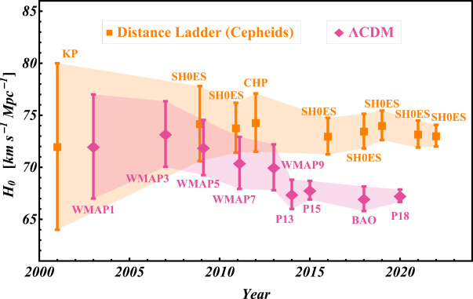
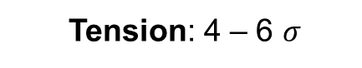
The Hubble Tension
The expansion of the Universe can locally be expressed by the Hubble-Lamaître law
Traditionally measured:
Cosmic Distance Ladder
ΛCDM – CMB
Uncertainties improve
Figure 1: Hubble Tension over time. Reproduced from Perivolaropoulos and Skara (2022).
Tension: 4 – 6 $σ$

Slide 3
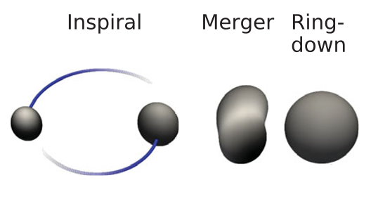
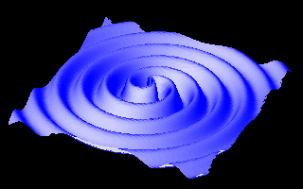
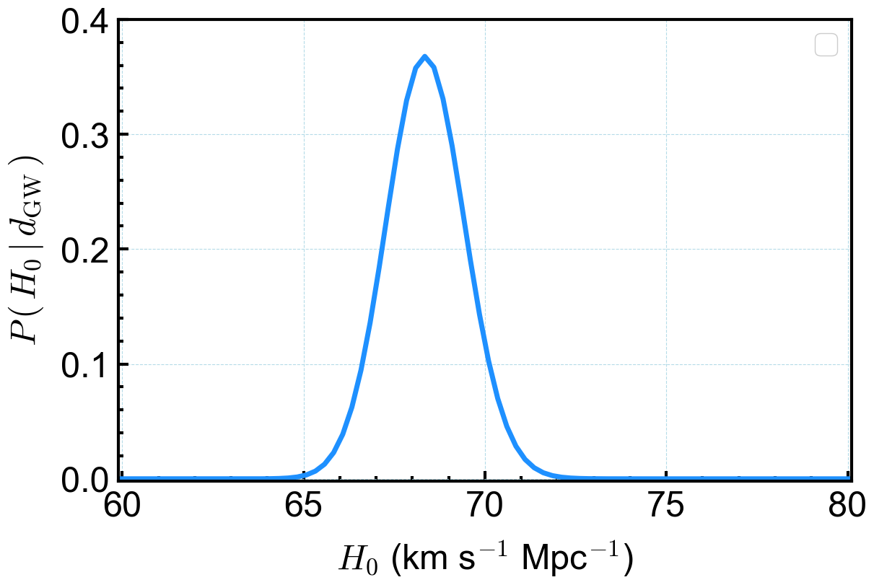
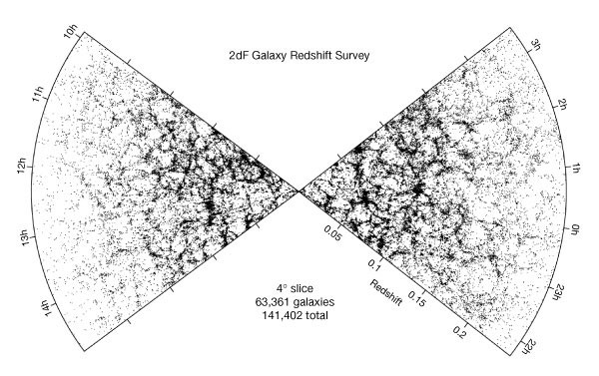
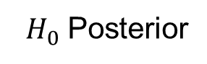
The Dark Siren Method
Independent distance measurement and sky localisation volume
Figure 2: BBH merger process. Reproduced from Abbott et al. 2016
Figure 3: Animation of GWs. NASA/JPL
Bayesian Inference
(possible host galaxies averaged over GW localisation volume)
$H_{0}$ Posterior
Figure 4: Example of galaxy survey. Reproduced from Peacock et al. 2001

Slide 4
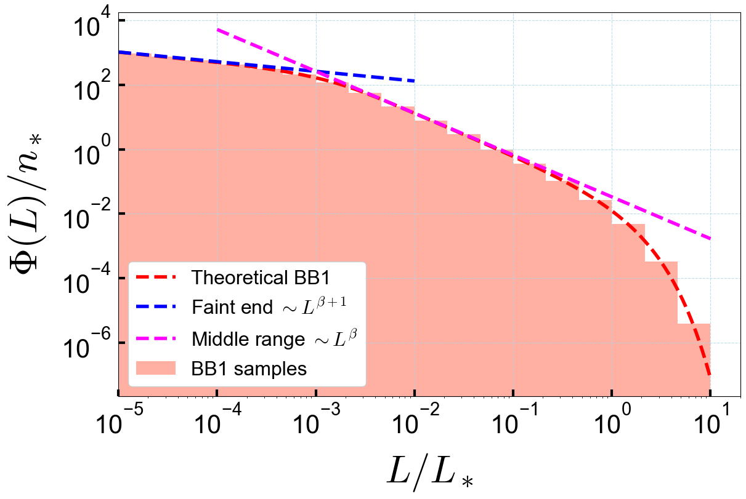
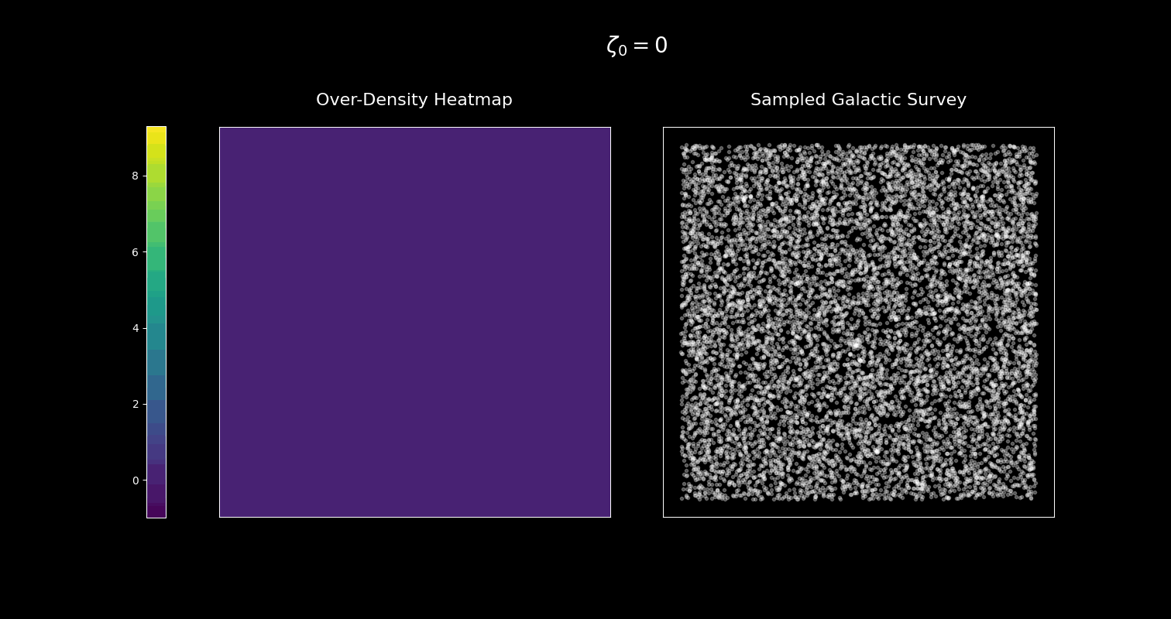

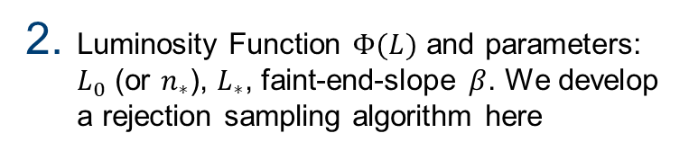
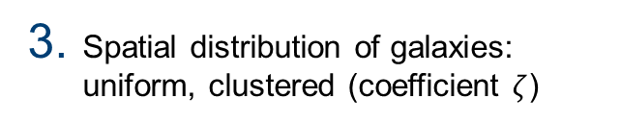
Smiulation Framwork
We simulate a simple version of a local Universe and set system properties
# dimensions, size, shape, $H_{0}$
Luminosity Function $Φ(L)$ and parameters: $L_{0}$ (or $n_{∗}$), $L_{∗}$, faint-end-slope $β$. We develop a rejection sampling algorithm here
Spatial distribution of galaxies: uniform, clustered (coefficient $ζ$)
Figure 6: Effect of clustering in the galaxy spatial distribution in our simulation for diferente clustering coefficients.
Figure 5: BB1 Gamma exemple. Histogram of 10⁵ samples and approximate behaviour of the pdf at diferente luminosity ranges.

Slide 5
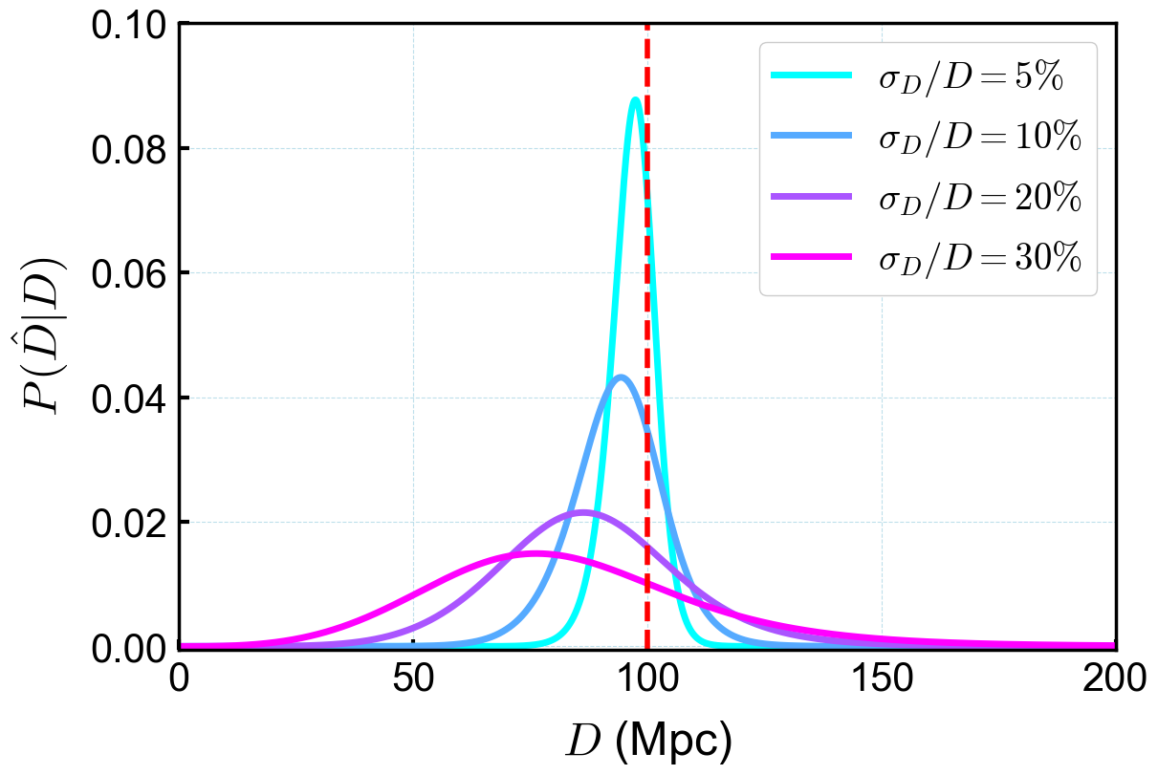
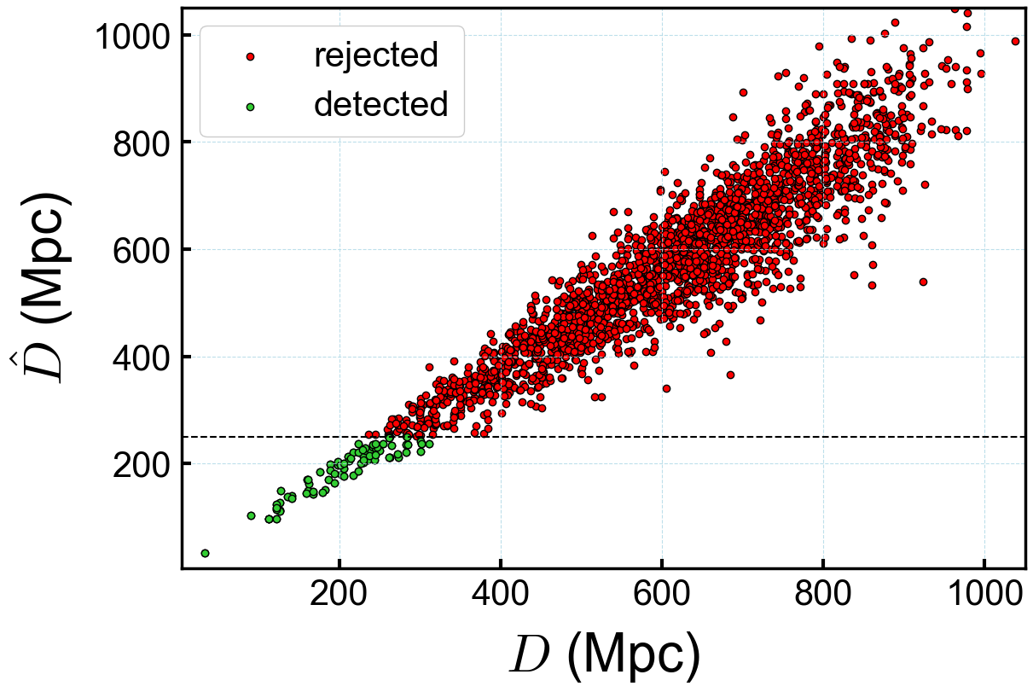
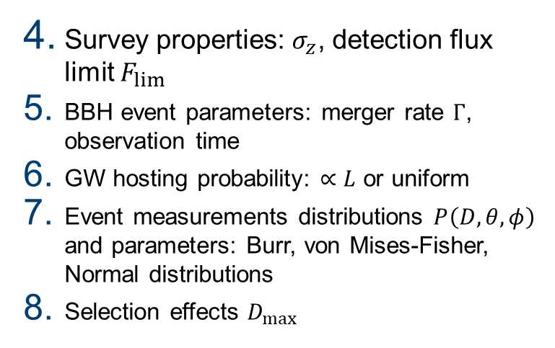
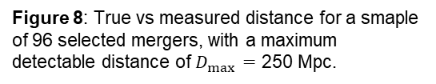
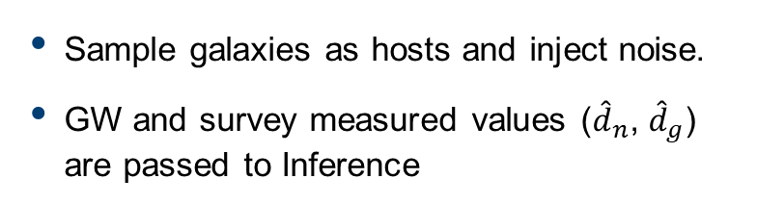
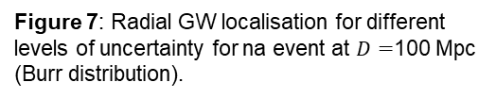
Smiulation Framwork
Survey properties: $σ_{z}$, detection flux limit $F_{lim}⁡$
BBH event parameters: merger rate $Γ$, observation time
GW hosting probability: $∝L$ or uniform
Event measurements distributions $P\left(D, θ, φ\right)$ and parameters: Burr, von Mises-Fisher, Normal distributions
Selection effects $D_{max}$
Figure 7: Radial GW localisation for different levels of uncertainty for na event at $D=$100 Mpc (Burr distribution).
Sample galaxies as hosts and inject noise.
GW and survey measured values (${\hat{d}}_{n}$, ${\hat{d}}_{g}$) are passed to Inference
Figure 8: True vs measured distance for a smaple of 96 selected mergers, with a maximum detectable distance of $D_{max }=$ 250 Mpc.

Slide 6

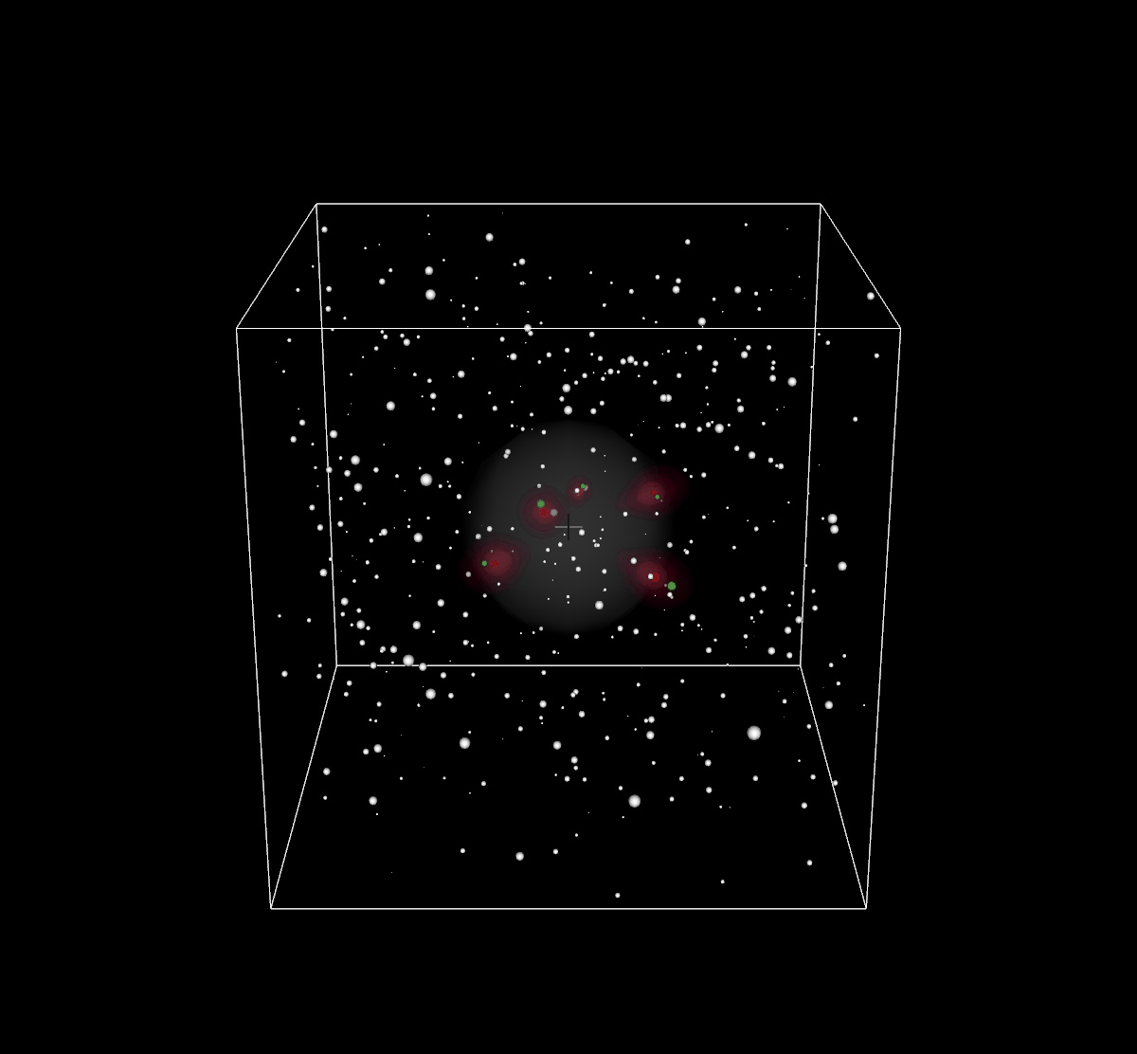

Slide 7
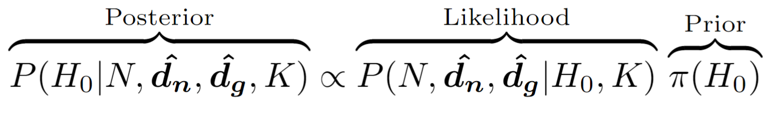
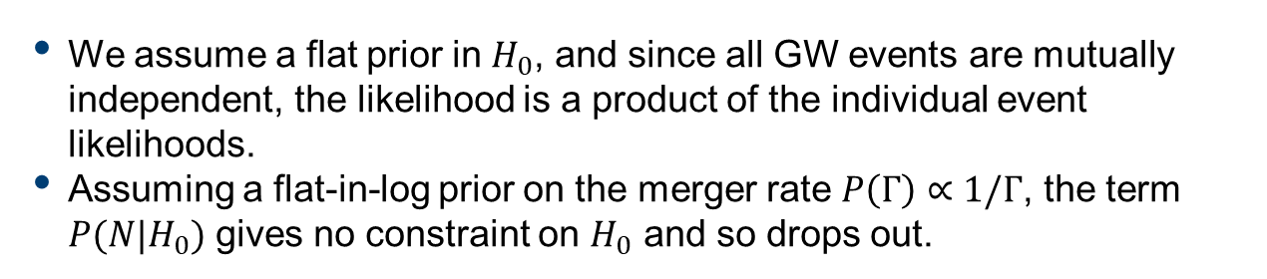
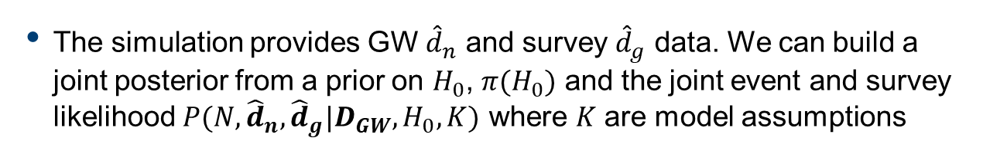
Bayesian Inference
The simulation provides GW ${\hat{d}}_{n}$ and survey ${\hat{d}}_{g}$ data. We can build a joint posterior from a prior on $H_{0}$, $π(H_{0})$ and the joint event and survey likelihood $P({N,\hat{d}}_{n},{\hat{d}}_{g}|D_{GW},H_{0},K)$ where $K$ are model assumptions
We assume a flat prior in $H_{0}$, and since all GW events are mutually independent, the likelihood is a product of the individual event likelihoods.
Assuming a flat-in-log prior on the merger rate $P\left(Γ\right)∝1/Γ$, the term $P(N|H_{0})$ gives no constraint on $H_{0}$ and so drops out.

Slide 8
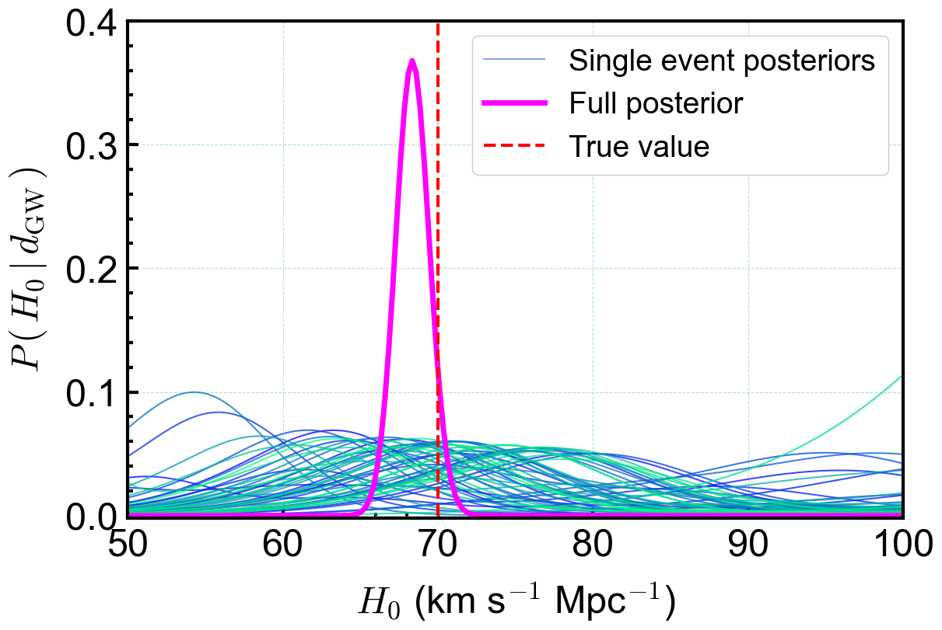
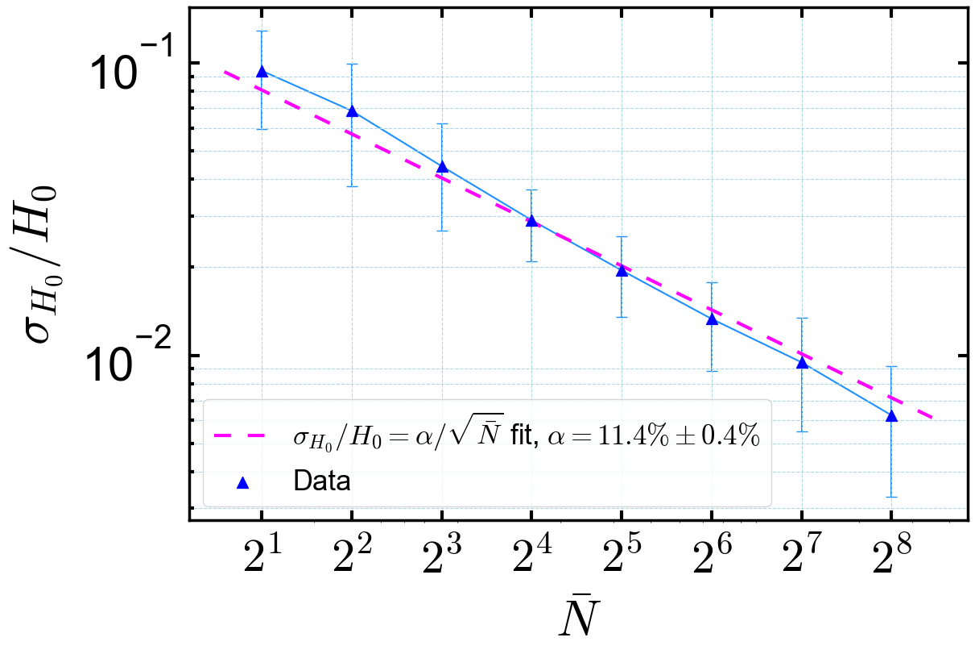
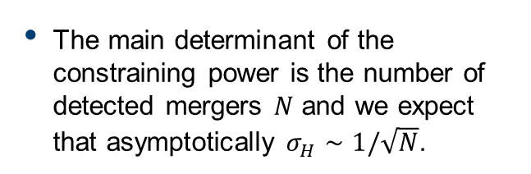
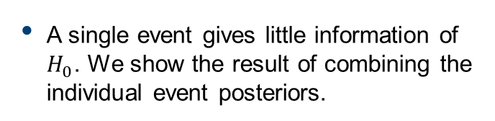
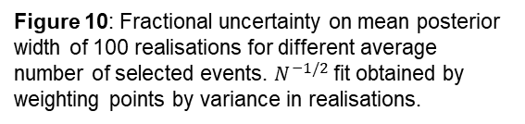
Results
A single event gives little information of $H_{0}$. We show the result of combining the individual event posteriors.
Figure 9: Individual event and full posteriors for a BBH sample of 51 events.
The main determinant of the constraining power is the number of detected mergers $N$ and we expect that asymptotically $σ_{H}∼1/\sqrt{N}$.
Figure 10: Fractional uncertainty on mean posterior width of 100 realisations for different average number of selected events. $N^{−1/2}$ fit obtained by weighting points by variance in realisations.

Slide 9
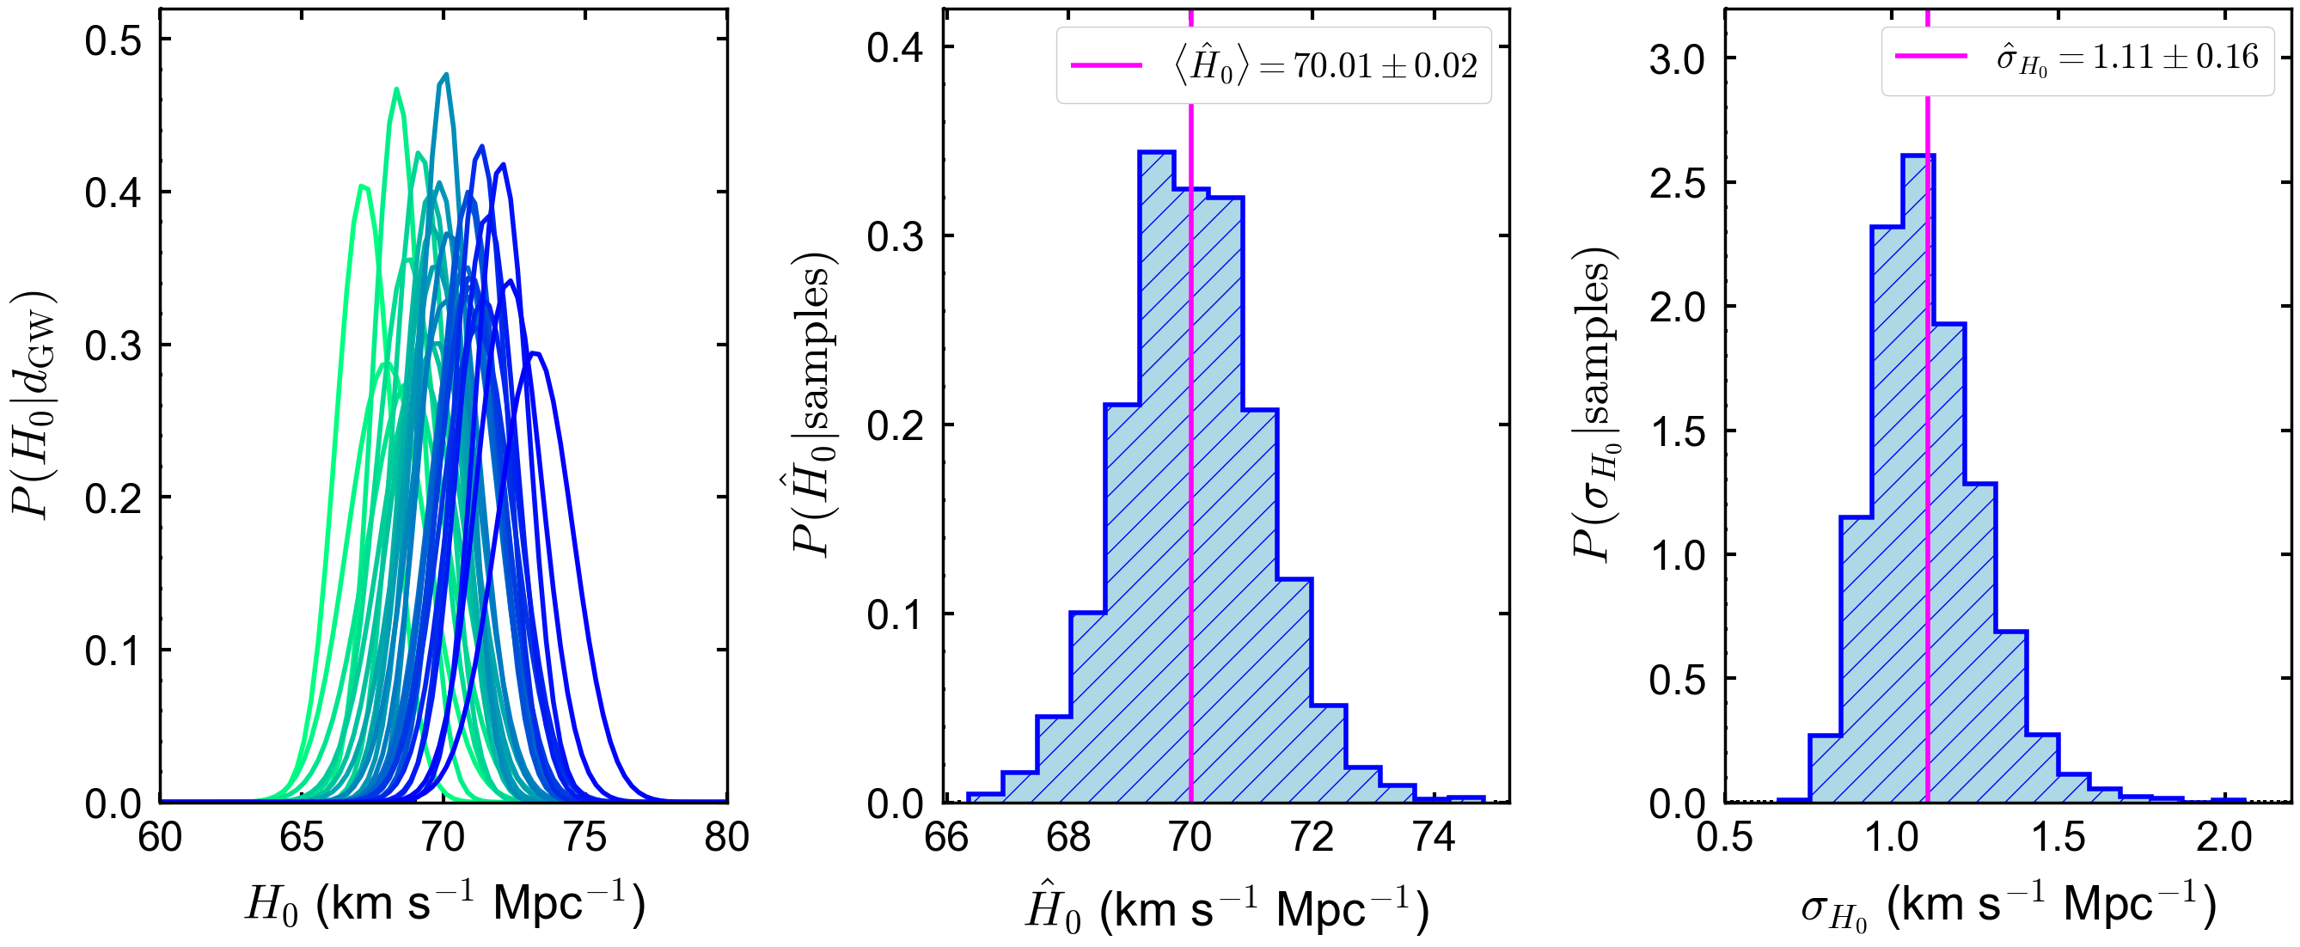
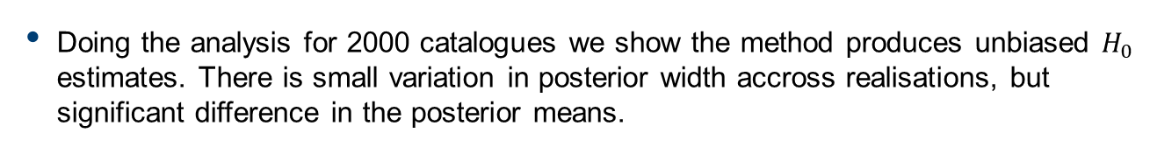
Results
Doing the analysis for 2000 catalogues we show the method produces unbiased $H_{0}$ estimates. There is small variation in posterior width accross realisations, but significant difference in the posterior means.
Figure 11: (left) 30 $H_{0}$ posteriors for $∼$50-BBH samples. (centre) Distribution of ${\hat{H}}_{0}$ (posterior means) and (right) posterior standard deviations for 2000 realisations. Means of ${\hat{H}}_{0}$ and $σ_{H_{0}}$ are plotted in magenta.

Slide 10
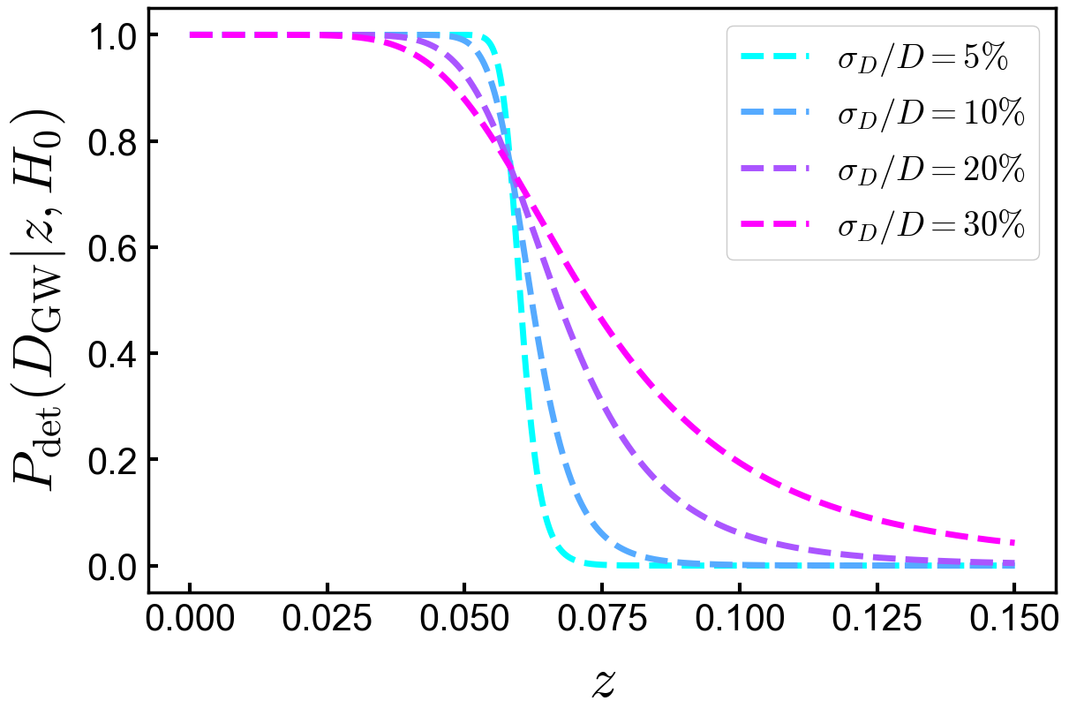
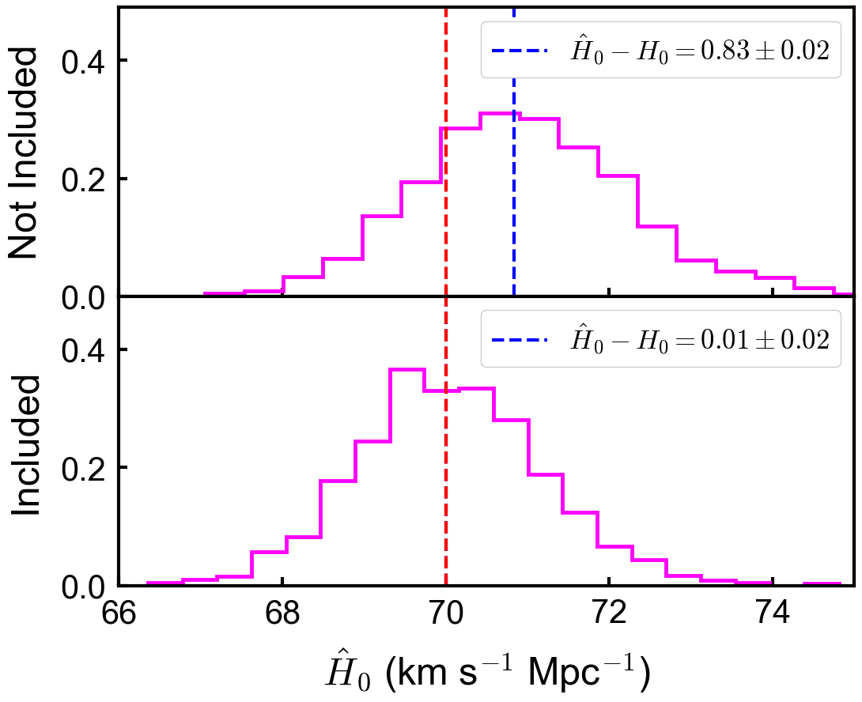
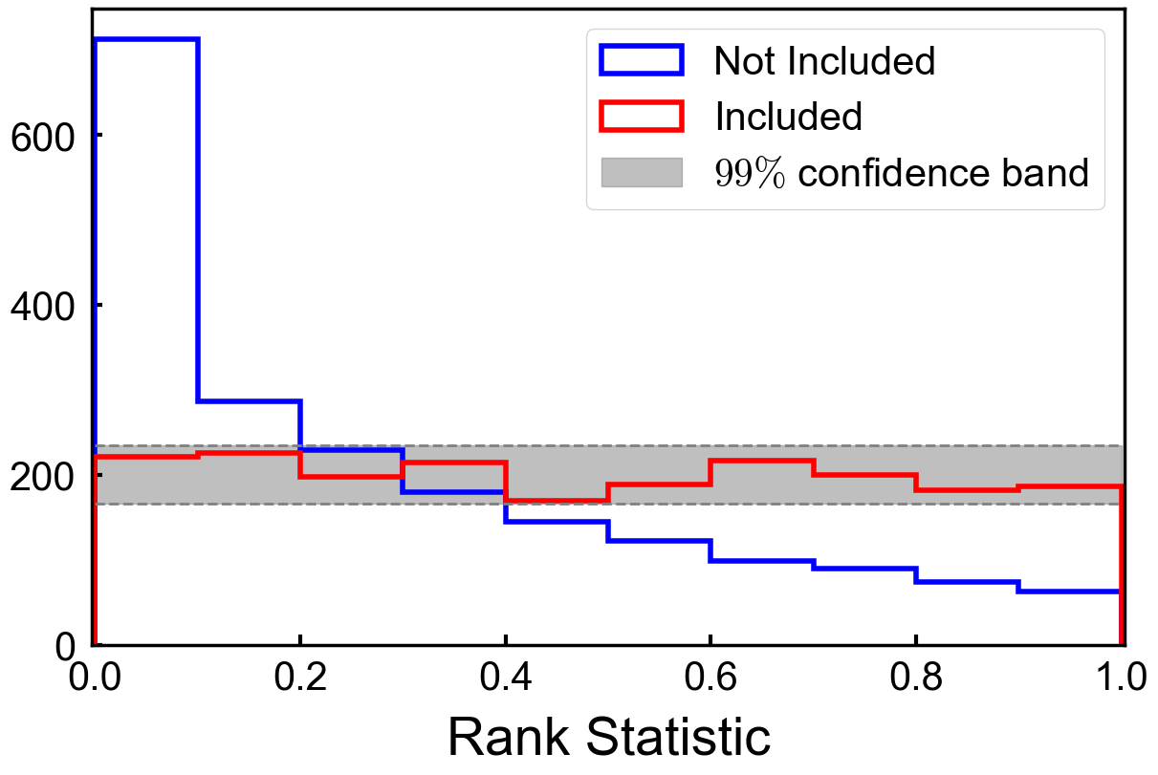
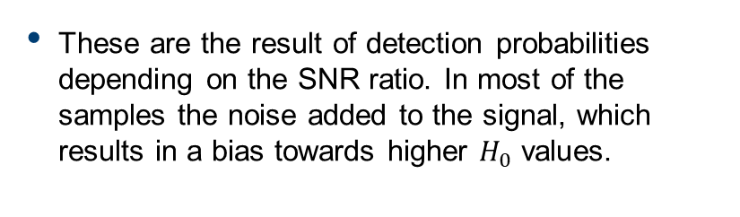
Results – Selection Effects
These are the result of detection probabilities depending on the SNR ratio. In most of the samples the noise added to the signal, which results in a bias towards higher $H_{0}$ values.
Figure 11:

Slide 11
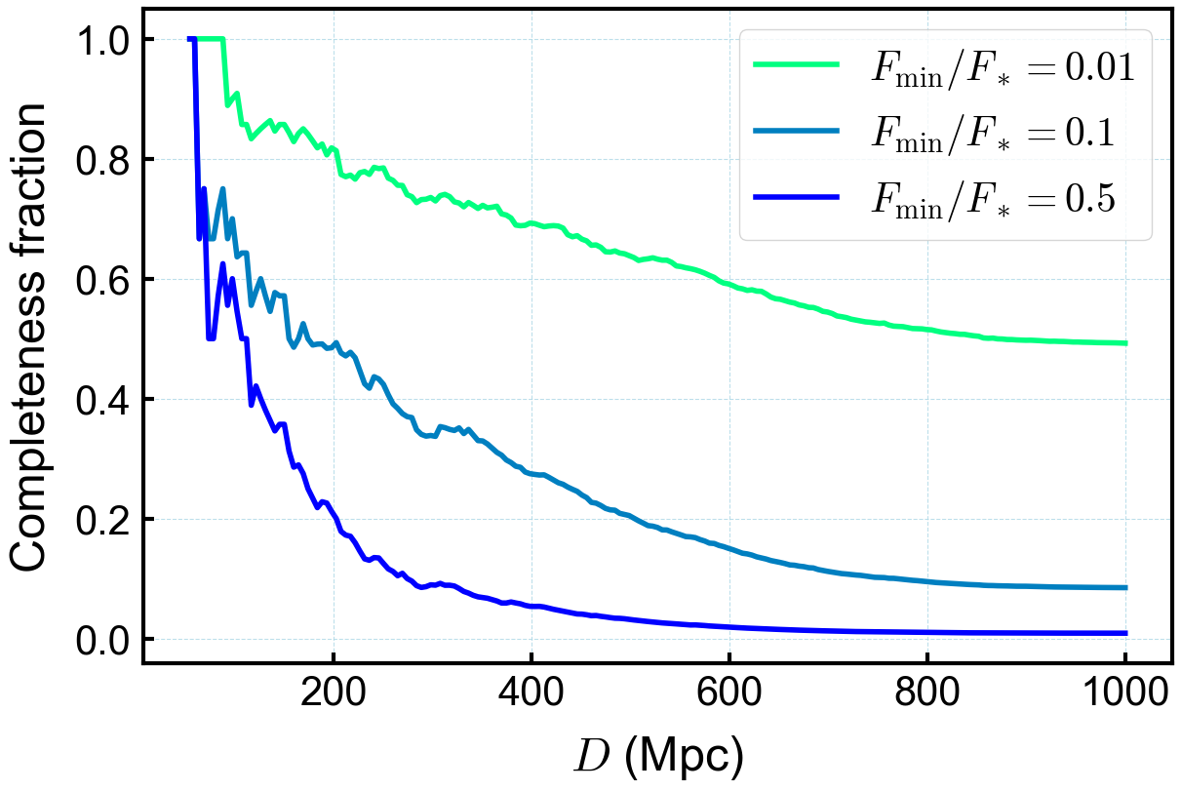
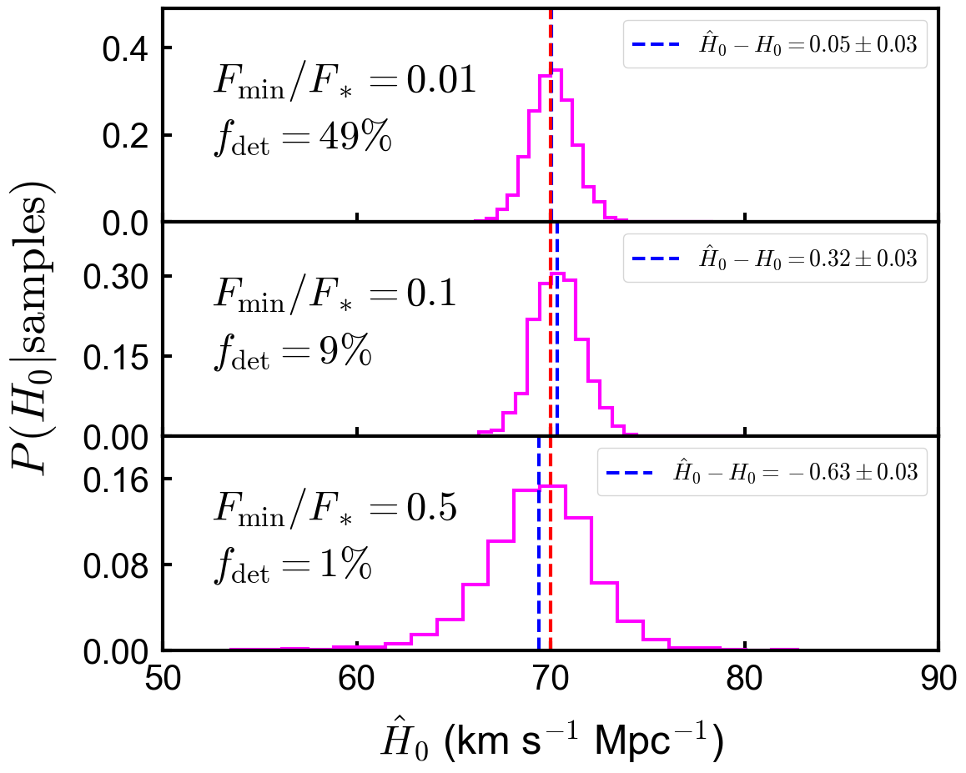
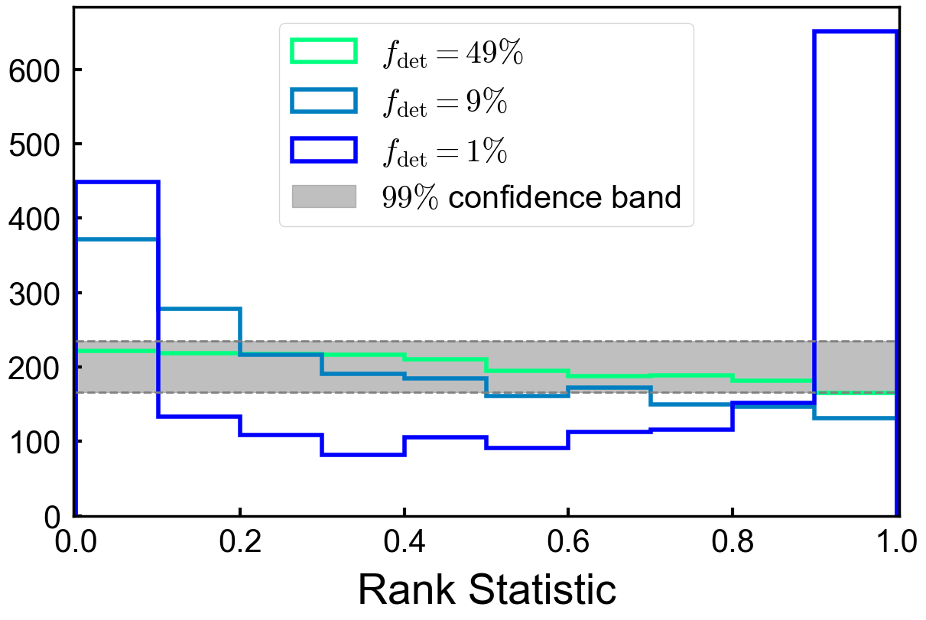
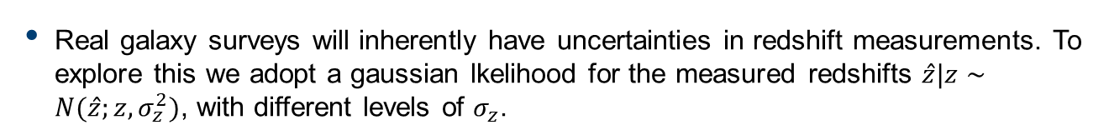
Results – Survey Completeness
Real galaxy surveys will inherently have uncertainties in redshift measurements. To explore this we adopt a gaussian lkelihood for the measured redshifts $\hat{z}|z∼N(\hat{z};z,σ_{z}^{2})$, with different levels of $σ_{z}$.

Slide 12
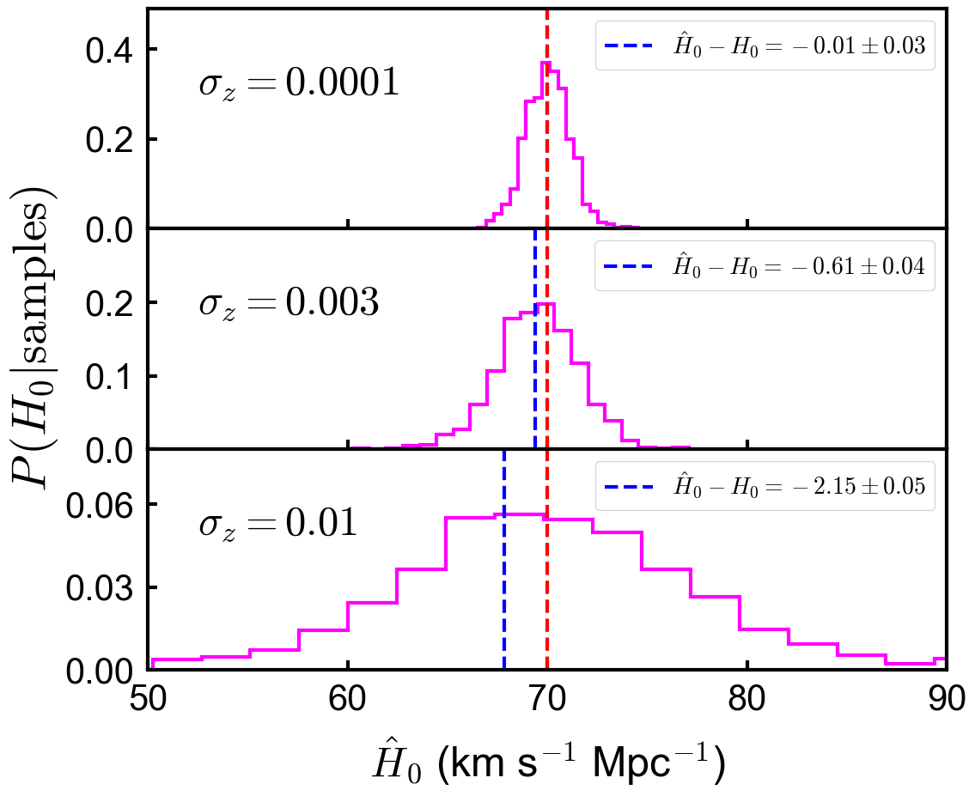
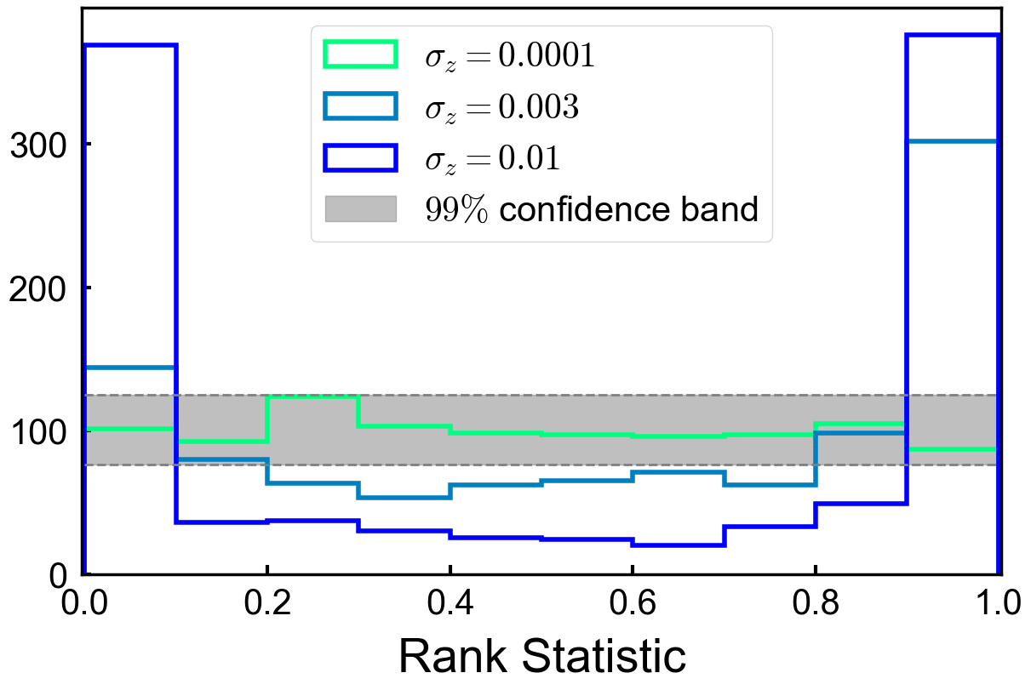
Results – Redshift Uncertainty
The large mass of BBHs means they are detectable at large distances (most distant at 2840 Mpc - LIGO 2019), where catalogues are often incomplete. We show those effects here.

Slide 13
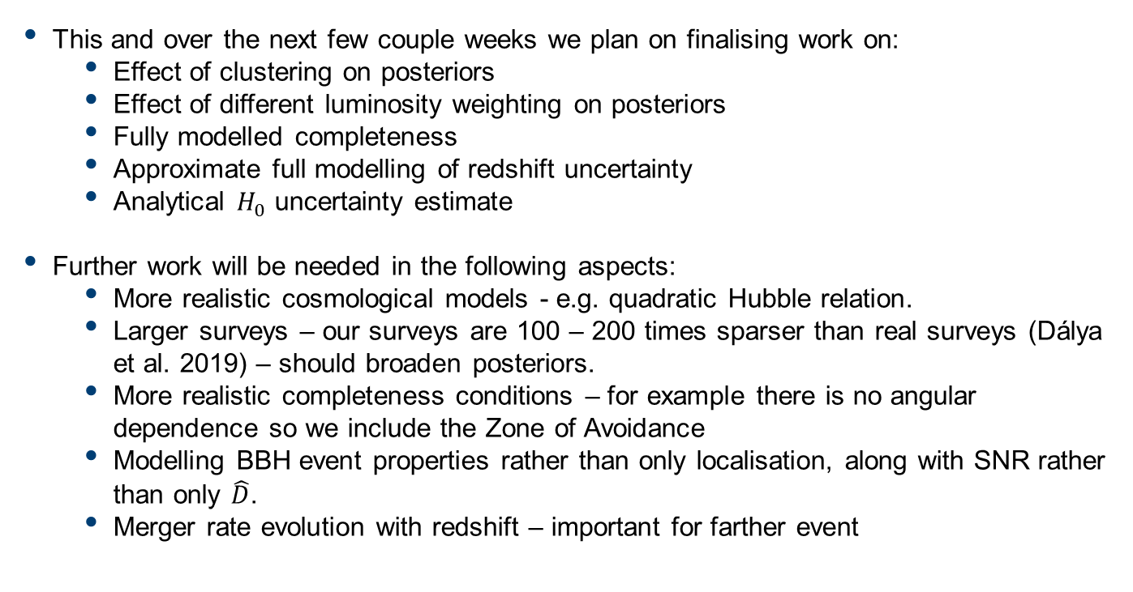
Next steps and possible extensions
This and over the next few couple weeks we plan on finalising work on:
Effect of clustering on posteriors
Effect of different luminosity weighting on posteriors
Fully modelled completeness
Approximate full modelling of redshift uncertainty
Analytical $H_{0}$ uncertainty estimate
Further work will be needed in the following aspects:
More realistic cosmological models - e.g. quadratic Hubble relation.
Larger surveys – our surveys are 100 – 200 times sparser than real surveys (Dálya et al. 2019) – should broaden posteriors.
More realistic completeness conditions – for example there is no angular dependence so we include the Zone of Avoidance
Modelling BBH event properties rather than only localisation, along with SNR rather than only $\hat{D}$.
Merger rate evolution with redshift – important for farther event
Notes:
Conclussions:
We show our model produces unvbiased estimates of H_0 using the dark siren method.
We diagnose the surfacing of iases when selection effects, redshift uncertainties and incomplete catalogs are not modelled

Slide 14
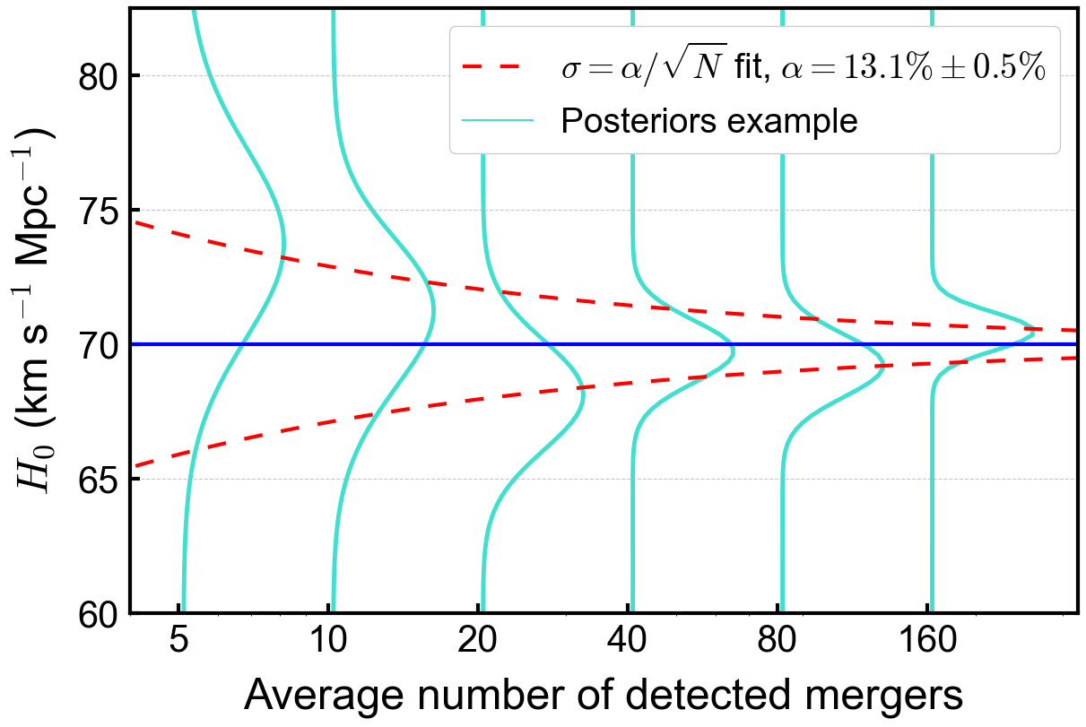
Appendix

Slide 15
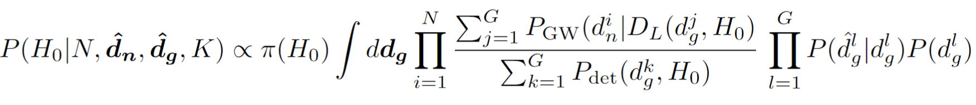
Appendix

Slide 16
Appendix
Figure 11:

